Slide 1
Library Management System
Submitted by: Group 2
Felipe Reichart
Anoj Kumar Shrestha
Kush Raj Rimal

Slide 2
Use Cases:
Login
Add a Library Member
Add a Book
Add copies of the book
Checkout Book

Slide 3
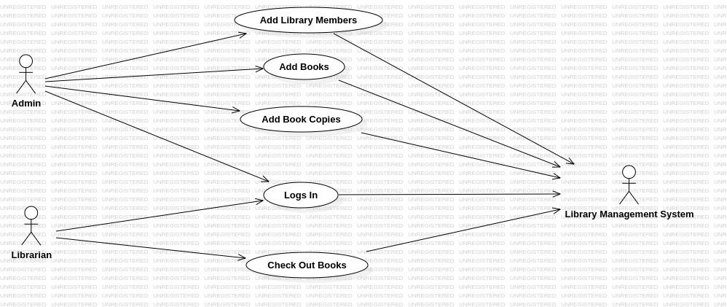
Use Case Diagram

Slide 4
Class Model
Involved Classes:
User
Book
BookCopy
Address
Author
LibraryMember
CheckoutRecord
CheckoutEntry

Slide 5
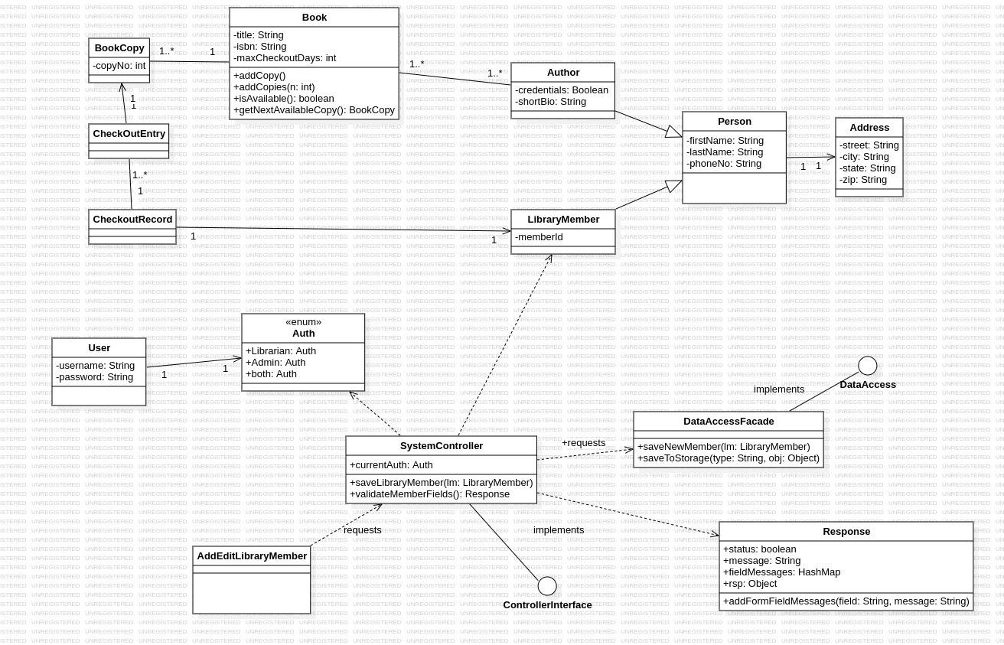
Class Diagram (New Library Member Use Case covered)

Slide 6
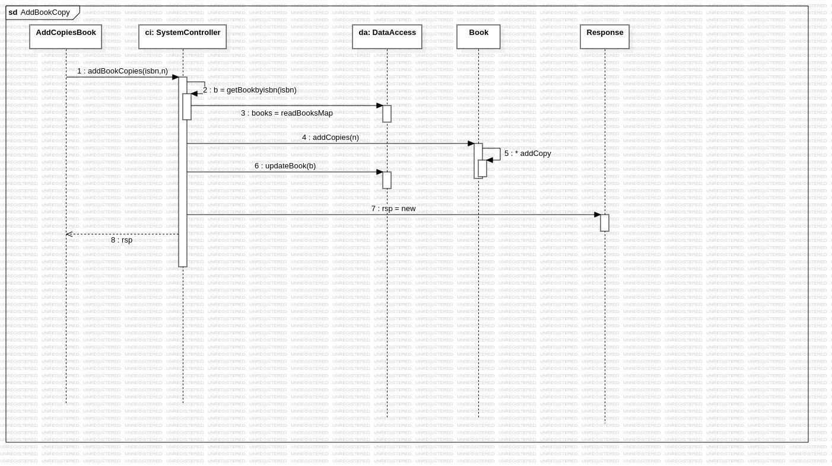
Sequence Diagrams:
Add a book Copy

Slide 7
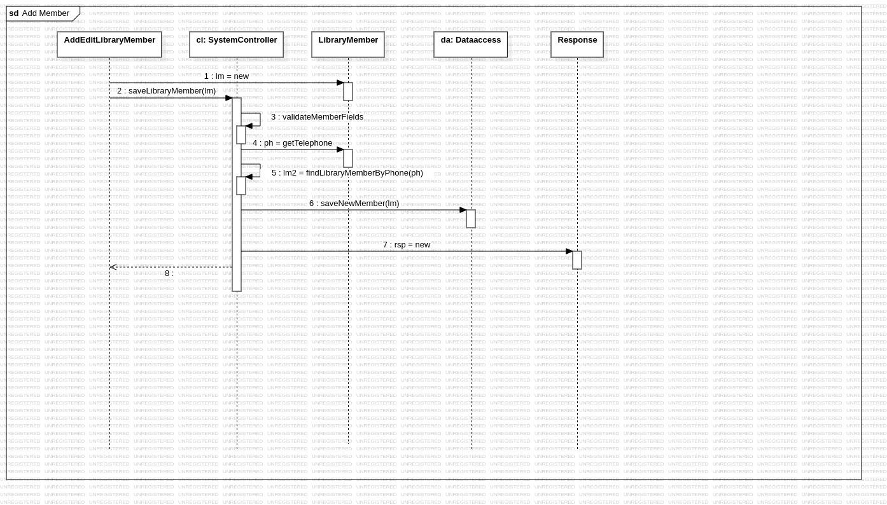
Add Library Member

Slide 8
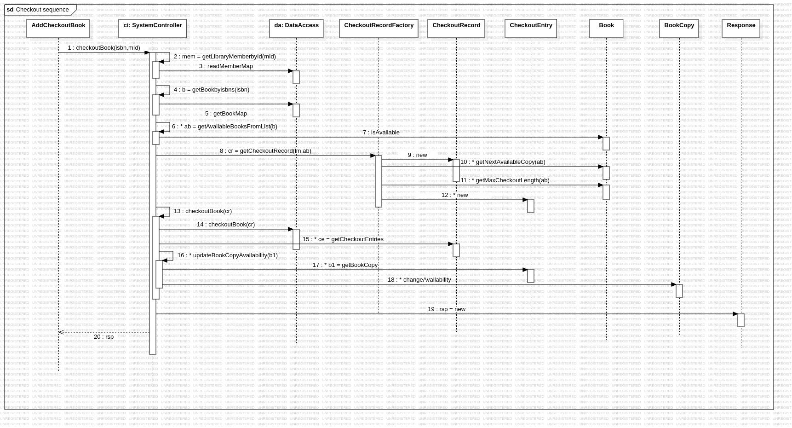
Checkout Book

Slide 9
Applied Validation Rules for UI
Login
check if username and password fields are not empty
check if the user with provided credentials is present in the system

Slide 10
Add a new Member
check if firstName is present
check if the phone number follows the format of a standard telephone number
check presence of address
check the zip code format and length
check is the state given is a valid US state's 2 letter representation

Slide 11
Add a new Book
check if the provided ISBN number is either of the ISBN10 or ISBN13 standard
checking the presence of title of the book
checking the number of copies parameter is strictly numeric.
checking if at least 1 author has been assigned to the book

Slide 12
Add copies of Book
Check if the no of copies parameter is strictly numeric

Slide 13
Checkout Book
check if the book with isbn no exists in the system
check if the member with given member id exists in system
check if the book with given isbn number is available for checkout

Slide 14
Conclusion
SCI Insights gained:
Just like the UI directs messages to the controller, dao layer and finally the raw data within the program to know about the truth, we too must go within ourselves to our consciousness and to find out the ultimate truth about life and ourselves.
Like we correct our inputs in the program continuously, so that it discovers all the validation requirements one by one, we too must dwelve to our consciousness continuously to find out about various aspects of our life and nature.
Maintaining the habit of to go an academic environment increment our sensibility about getting new knowledge and make interest contacts. Developing this system introduce us to think more about what books we read and what will be next books enhancing the motivation of to write as well.

